Slide 1
To play Jeopardy – start this .ppt in SLIDE SHOW MODE, and click through the slides. When you get to the game board, click on a square – the answer and then question will appear.
Click again to return to the game board.
Good luck!

Slide 2


Slide 3
SAFETY 1ST

Slide 4
ZEBRA SONGS

Slide 5
WHO’S WHO

Slide 6
BY THE CLOCK

Slide 7
YOU’RE GROUNDED

Slide 8
GOOD AS GOALED

Slide 9
SAFETY 1ST
ZEBRA SONGS
WHO’S WHO?
BY THE CLOCK
YOU’RE GROUNDED
GOOD AS GOALED
$100
$100
$100
$100
$100
$100
$200
$200
$200
$200
$200
$200
$300
$300
$300
$300
$300
$300
$400
$400
$400
$400
$400
$400
$500
$500
$500
$500
$500
$500

Slide 10
These safety items must be worn by players in the field of play?

Slide 11
What are helmet, chest pad, shoulder pads, arm pads, & mouth guard?

Slide 12
Player A1 shoots on goal, after a stick check, the official rules the stick as illegal.

Slide 13
What is no goal + 2-minute non-releasable penalty?

Slide 14
Apparatus used to control heart fibrillation.

Slide 15
What is an AED?

Slide 16
Player B2 is wearing football pads.

Slide 17
What is illegal equipment (1-min NR personal foul)?

Slide 18
Disruption of heart rhythm often caused by hard hit to the chest

Slide 19
What is Commotio Cordis?

Slide 20
Carry, Cradle, Pass, Shoot.

Slide 21
What is possession?

Slide 22
Player B1 gains possession in his defensive box and crosses the midline in 15 seconds. He drops the ball, A1 gains possession.

Slide 23
What is failure to advance (No clear) and GB for A1?

Slide 24
The only player number the officials request prior to the game starting.

Slide 25
What is the
in-home man?

Slide 26
An official makes an
L-shaped signal
using his arms.

Slide 27
What is stalling /
aka “keep it in?”
(Ball must not leave the box area; otherwise a turnover.)

Slide 28
Player B1 receives another personal foul, making the total 6-minutes.

Slide 29
What is Fouling-Out?
(Player will serve
full time prior to leaving the game.)

Slide 30
This organization sets rules for youth & boys lacrosse.

Slide 31
What is NFHS?

Slide 32
This committee who sets safety standards.

Slide 33
What is NOCSEA?

Slide 34
This governing body develops officials and coaches training, plus player development.

Slide 35
What is US Lacrosse?

Slide 36
This person keeps the official record of the game.

Slide 37
What is the Home-team Scorekeeper?

Slide 38
The people you watch
for game play
actions & results.

Slide 39
Who are the officials?

Slide 40
12 Minutes,
10 Minutes, or 8 minutes

Slide 41
What is the length of a quarter?

Slide 42
2 Minutes

Slide 43
What is the time of an intermission or timeout?

Slide 44
This gets the officials’ attention to return to the table.

Slide 45
What is a double toot of the horn?

Slide 46
Time served for
technical fouls.

Slide 47
What is up to 30 seconds?

Slide 48
A goal is scored at 7:32 in 3rd quarter making the score 14-2.

Slide 49
What is running clock?

Slide 50
A defensive long-pole intercepts a pass.

Slide 51
What is a ground ball?

Slide 52
Player A shoots the ball, and it hits the metal part of the goal.

Slide 53
What is a blocked shot?

Slide 54
At faceoff, after a scrum, Player A1 kicks the ball, Player B1 scoops the ball, drops it and Player A2 picks up the ball and runs with it.

Slide 55
What is FO Win for A1 and GB for A2?

Slide 56
Player A1 shoots,
ball hits Goalie,
A1 scoops, shoots & scores.

Slide 57
What are 2 shots (1 on goal) for A1, GB for A1, Goal for A1?

Slide 58
A1 shoots. Goalie sticks his stick offside and catches ball far side of goal pipe.

Slide 59
What is Shot for A1, and a GB for Goalie?

Slide 60
This is the ring around the goal with a 9’ radius.

Slide 61
What is a crease?

Slide 62
A goalie stops a ball from the opposing team’s possession from going into the goal.

Slide 63
What is a save?

Slide 64
The one person on the field formally acknowledging a scored goal?

Slide 65
What is a game official on the field?

Slide 66
A ball rolls into the goal off of a defensive player as a botch.

Slide 67
What is a TEAM goal for the opposing team?

Slide 68
On a fast break, Player A1 / Goalie, passes to Player A2 who shoots and scores.

Slide 69
What is a Goal for A2,
an Assist for A1 (Goalie) and a Clear?

Slide 70
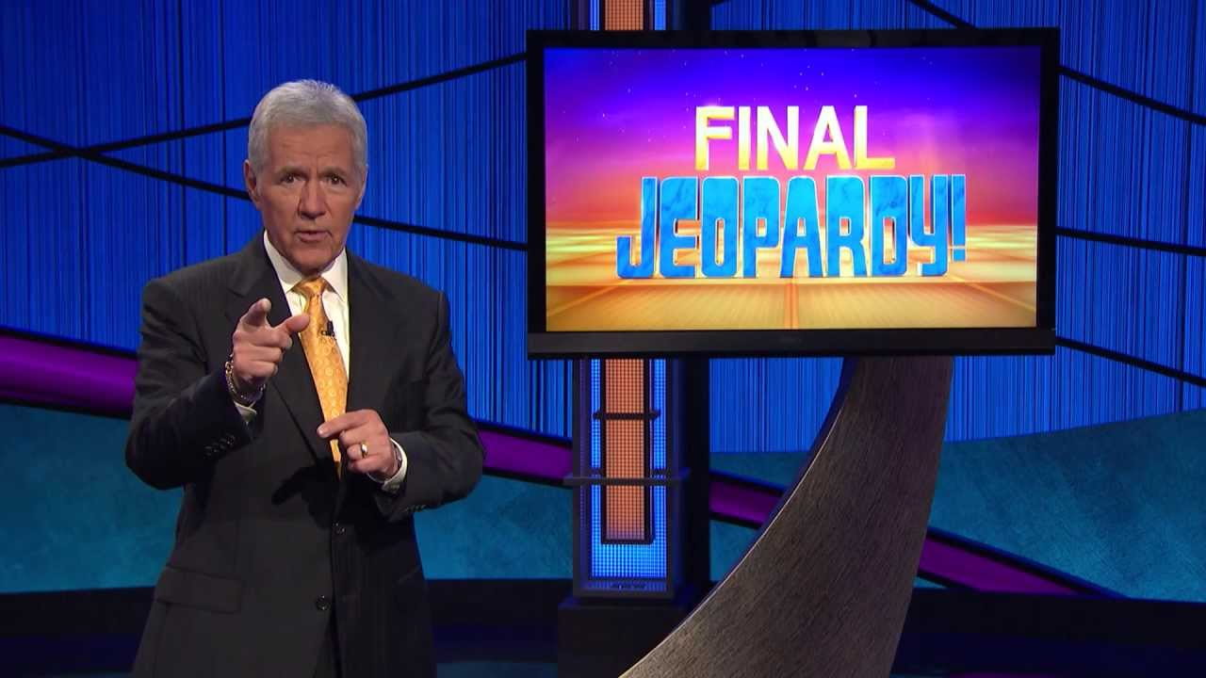

Slide 71
The reason we sit in the cold, with another stranger, and tally marks in a book while watching boys play a game.

Slide 72
What is love?

